Slide 1
Body Freedom Flutter and the X-56A
Create and Deliver Superior Products Through Innovative Minds
Aeroservoelastic Workshop
NASA Langley Research Center
April 18-19, 2012
Jeff Beranek
MAD Deputy Program Manager
John Scarcello
Research Engineering Manager

Slide 2
Outline
Problem Statement
Body Freedom Flutter IRAD & CRAD
X-56A Program Overview
Conclusion

Slide 3
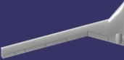
Rigid / Flex Coupling (RFC)
Low Tail Volume
High Fineness Ratio
SensorCraft
QSST
Classified I
SR
-
71A
DarkStar
QSST
Classified II
Lockheed SST
SensorCraft
OFW
Polecat
Conceptual LRS
Rigid / Flex Coupling Is Significant In Current and Future Designs

Slide 4
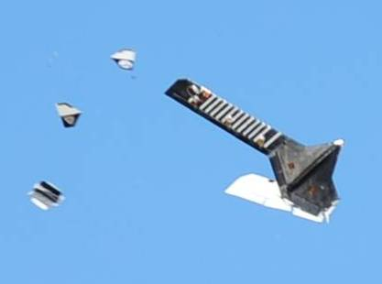
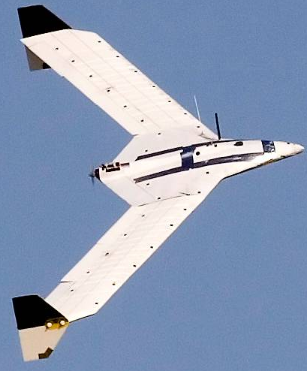
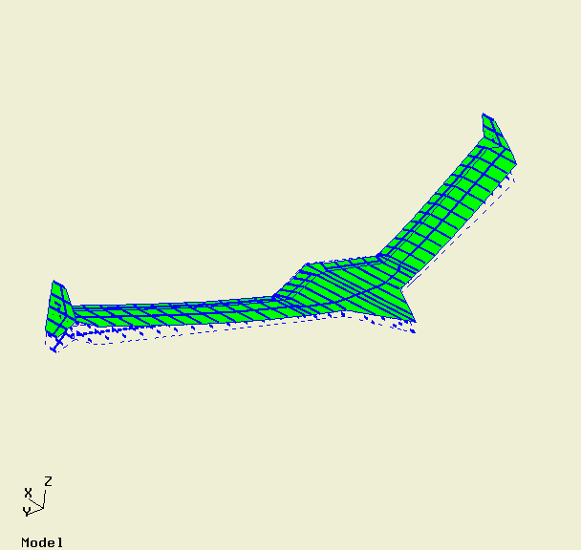
Rigid / Flex Coupling
UNSTABLE
STABLE
BFF Shape
Rigid / Flex Coupling – Ranges from Poor Flying Qualities to BFF

Slide 5
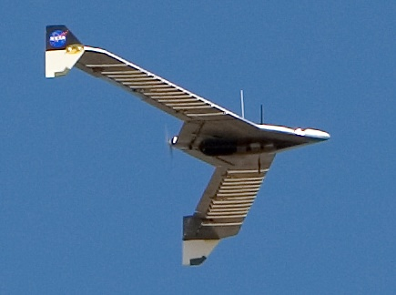
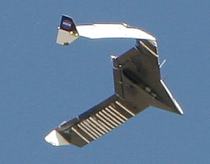

BFF IRAD & CRAD
BFF IRAD 2005-2007
5 Aircraft Built and Test Flown
Verified Ability to Predict BFF Onset
BFF04 First BFF Suppression
BFF05 Multiple Flutter Modes Suppressed
BFF AFRL CRAD 2009
2 Aircraft Built and Test Flown
Included Leading Edge Stagnation Point (LESP) Sensors
BFF06 LESP for BFF Control
BFF07 Additional Flutter Suppression Control Development

Slide 6

BFF IRAD & CRAD Video

Slide 7
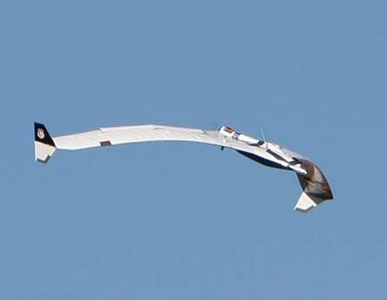
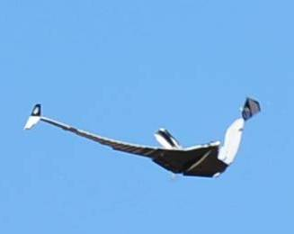
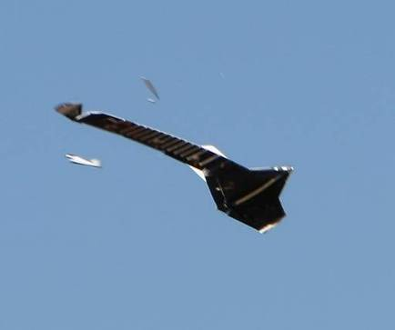
BFF IRAD & CRAD Summary
Vehicle | Sensor | Effector | Open Loop | Closed Loop | Notes
BFF01 | N/A | N/A | 46 | N/A | 1st Open loop
BFF02 | N/A | N/A | 46 | N/A | Verify open loop, obtain TF data
BFF03 | Pitch Rate | Outboard Flap | 44 | 47 | Missed pitch rate transport delay
BFF04 | CB Accels | Body Flap | 48 | 66 | BFF Suppression, destruction due to wing B/T flutter
BFF05 | CB & Wing Accels | Outboard Flap | 44 | 75 | BFF suppression, realized MFMC, destruction due to amplitude limit
BFF06 | LESP | Body Flap | 44 | 45 | LESP transport delay incorrectly specified
BFF07 | CB & Wing Accels | Body & Outboard Flap | 44 | 73 | Fuzzy logic MFMC successful, destruction due to amplitude limit
Demonstrated Suppression of Multiple Flutter Modes

Slide 8
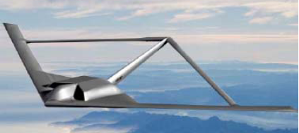
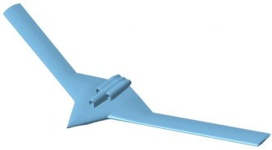
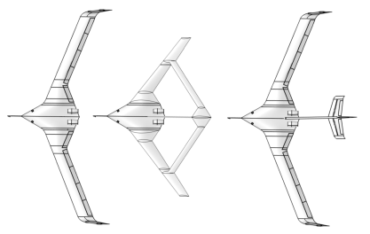
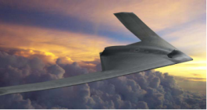
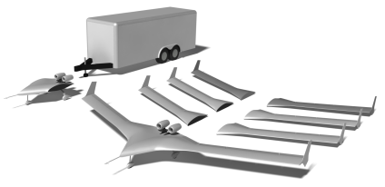
MAD Program
MAD is the Program
The Vehicle is a MUTT
X-56A is MAD
MUTT
MAD
IFAC
IFAC – Integrated Flight and Aeroelastic Controls

Slide 9
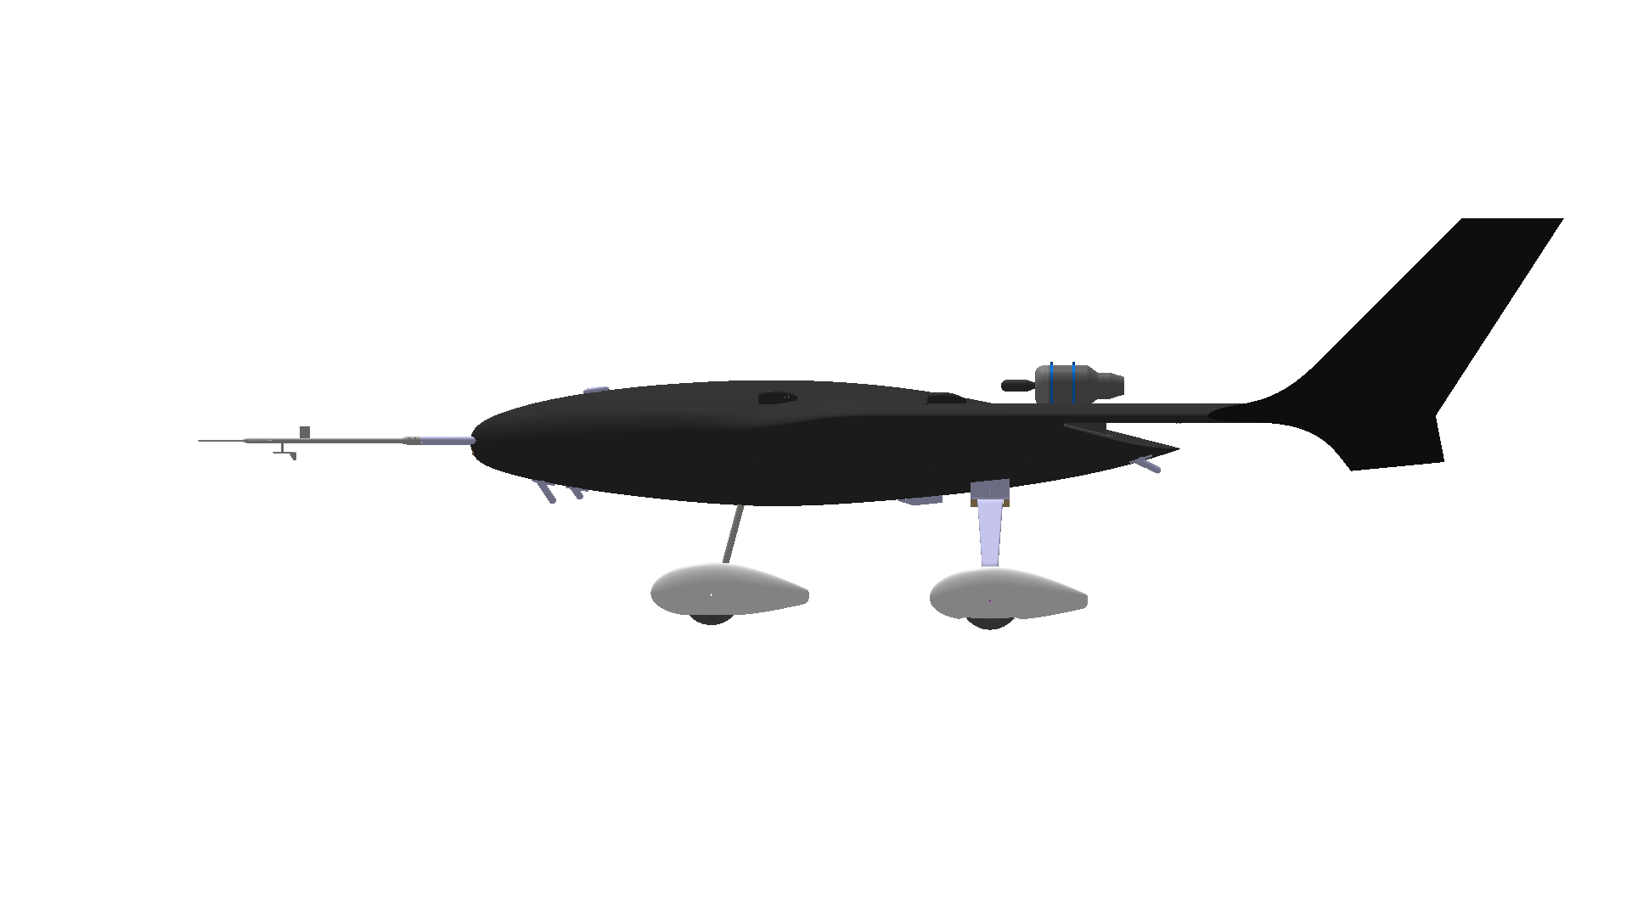
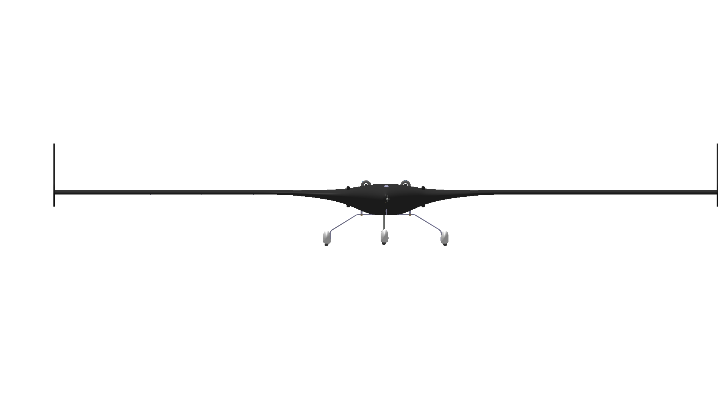
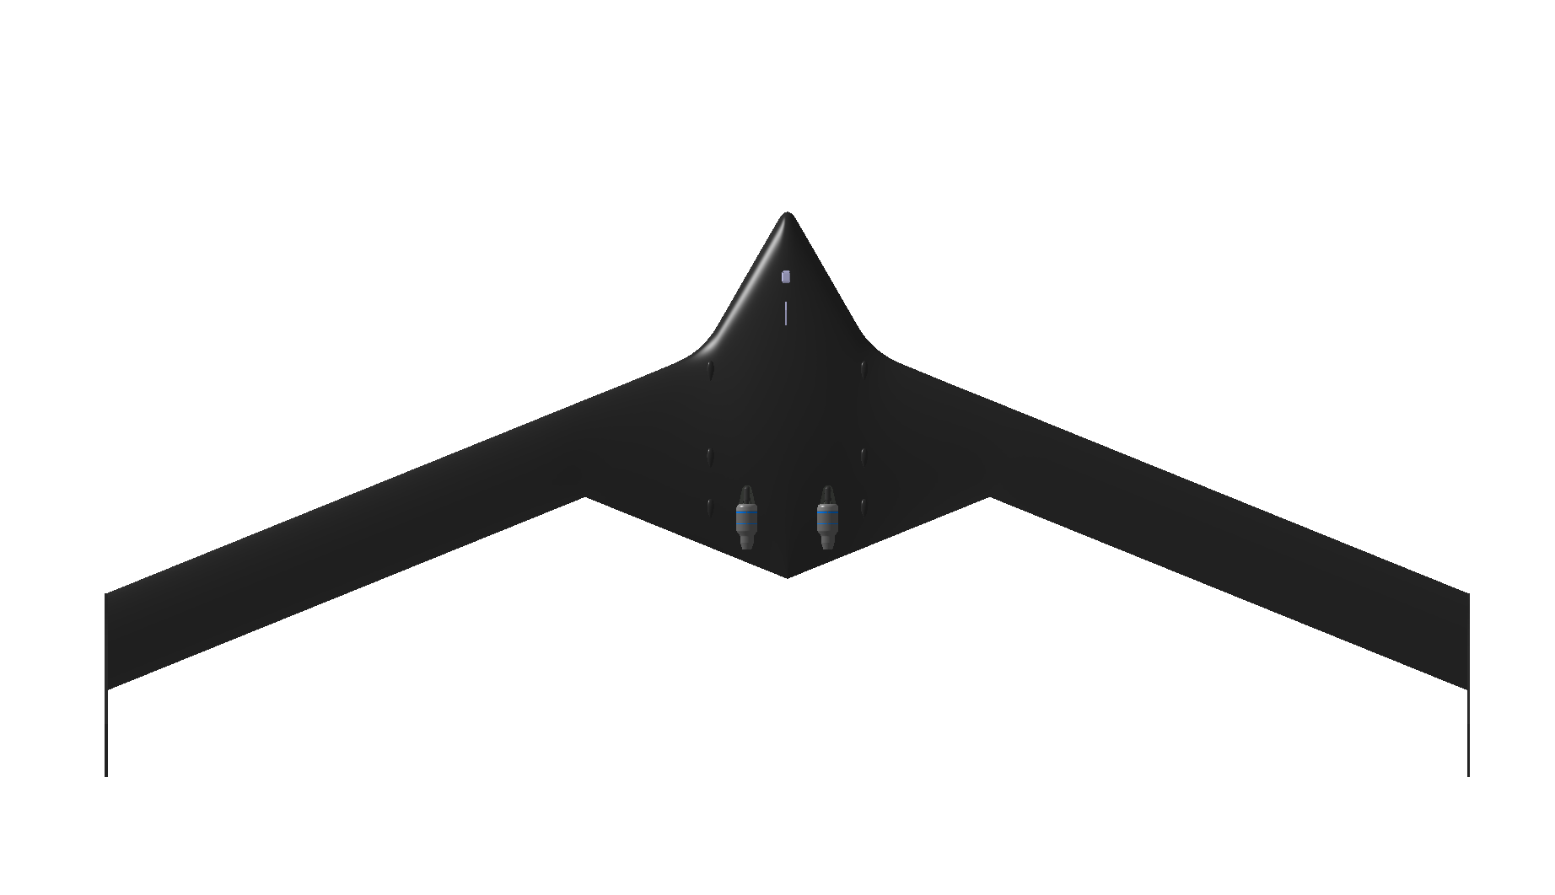
MAD/MUTT X-56A
M.A.C. 2.00 ft
Root Chord 4.33 ft
Thickness Ratio 16.5%
Tip Chord 2.00 ft
Thickness Ratio 10.0%
Body Flap Reference Area (Ea) 1.10 ft2
Control Surface Reference Area (Ea) 1.15 ft2
Winglet Reference Area (Ea) 3. 90 ft²
Winglet Height 2.58 ft
27.3”
5.5°
15.8”
24.6”
31”
52.4”
TOGW 480 lb
Reference Area 56.0 ft²
W/S 8.6 lb/ft²
T/W 0.225
Span 28.0 ft
Aspect Ratio 14.0
Fuselage Length 7.56 ft
Fuselage Depth 1.33 ft
Total Height 4.37 ft
Fuselage Width 3.17 ft
Wetted Area 170.70 ft²
Fuselage 41.27 ft²
Wing 113.43 ft²
Winglet 16.00 ft²
Wing Leading Edge Sweep 22.00°
Wing Trailing Edge Sweep 22.00°
Fuselage Leading Edge Sweep 60.00°
Fuselage Trailing Edge Sweep -22.00°
19”
Wing / Body Break
10”
Centerline to Thrust Axis
14’
Half Span

Slide 10
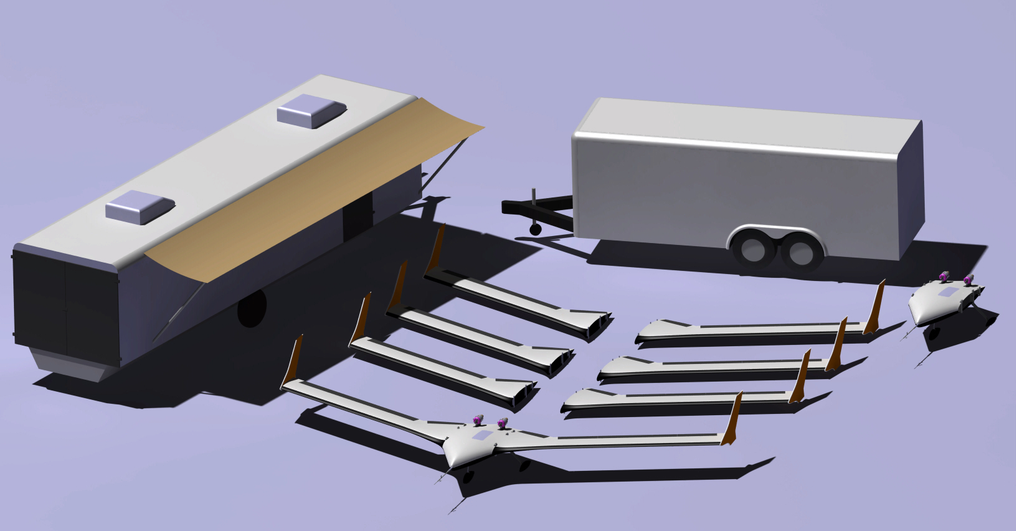
Multi-utility Aeroelastic Demonstration
Complete Research System
2 Center Bodies
1 Stiff Wing Set
3 Flexible Wing Sets
1 Ground Control Station
With Simulation and SIL Capabilities

Slide 11
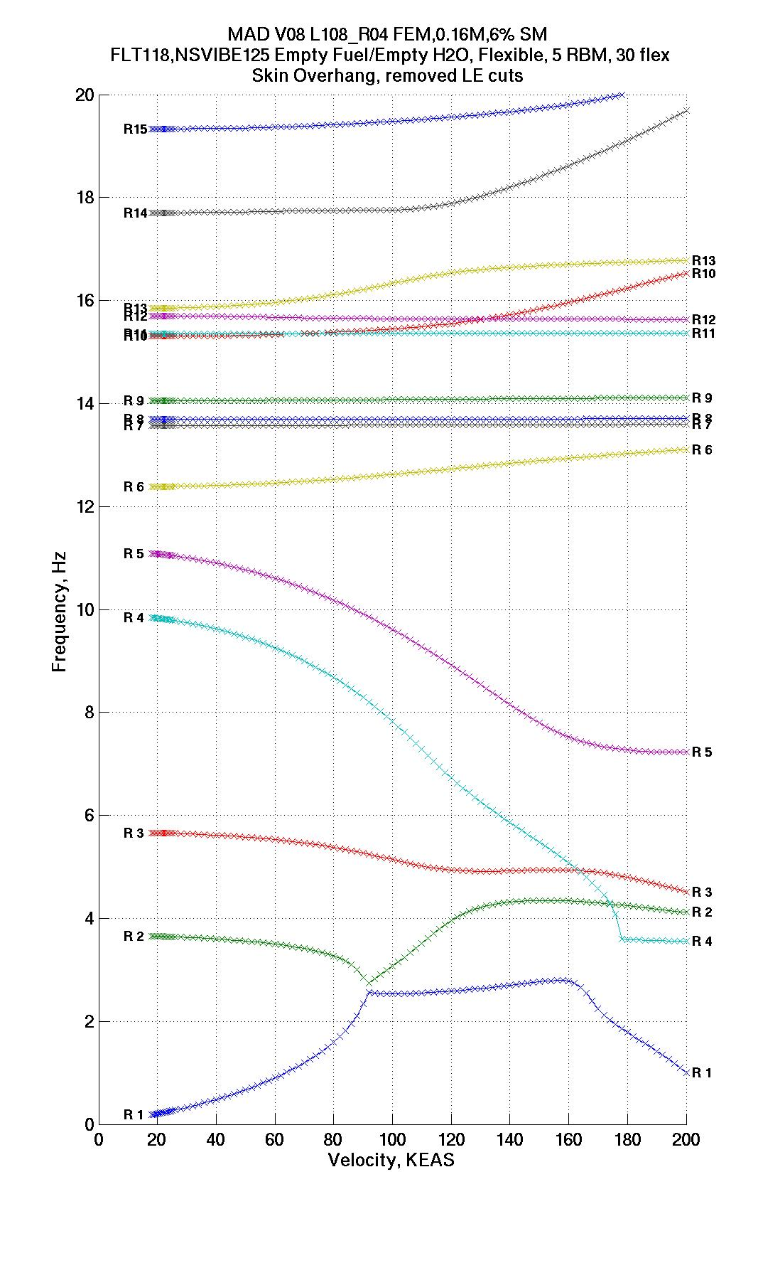
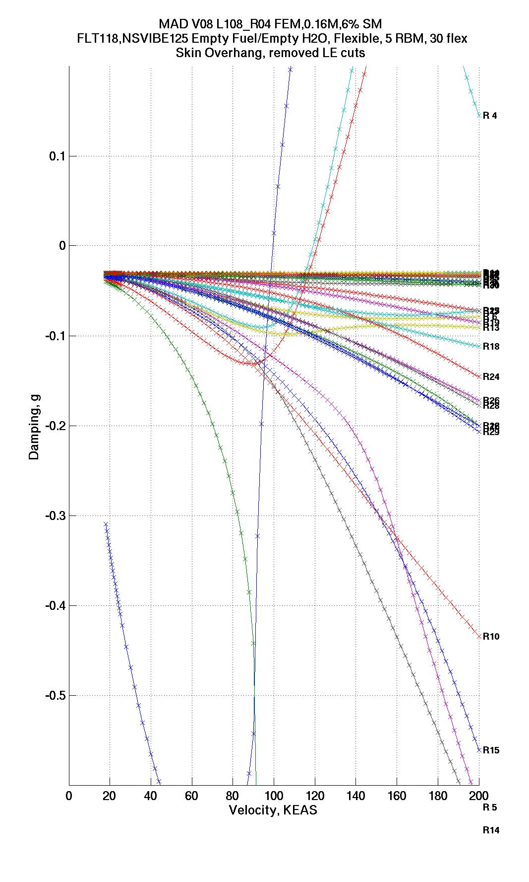
X-56A Flex - Empty
Flex wing empty fuel flutter achieves desired speeds for minimal kinetic energy
Body freedom flutter ~100 KEAS
Symmetric wing bending/torsion ~119 KEAS
Anti-symmetric wing bending/torsion ~121 KEAS
SWBT
UNSTABLE
BFF
AWBT
STABLE
AW1T
SW1T
AW1B
SW1B
Desired Flutter Band
Short Period
V_{L}
Demonstrator Achieves Desired Flutter Behavior

Slide 12
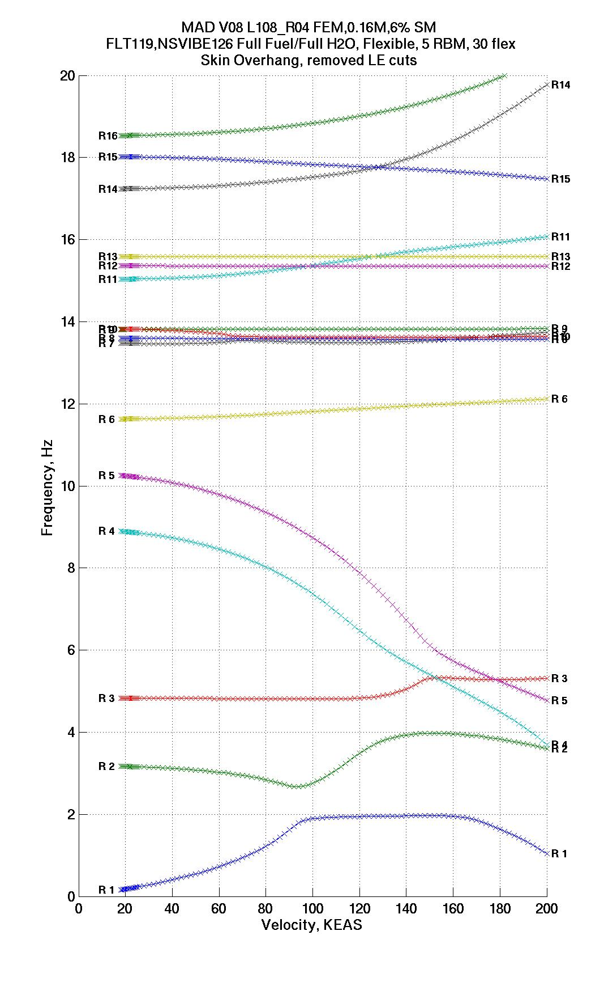
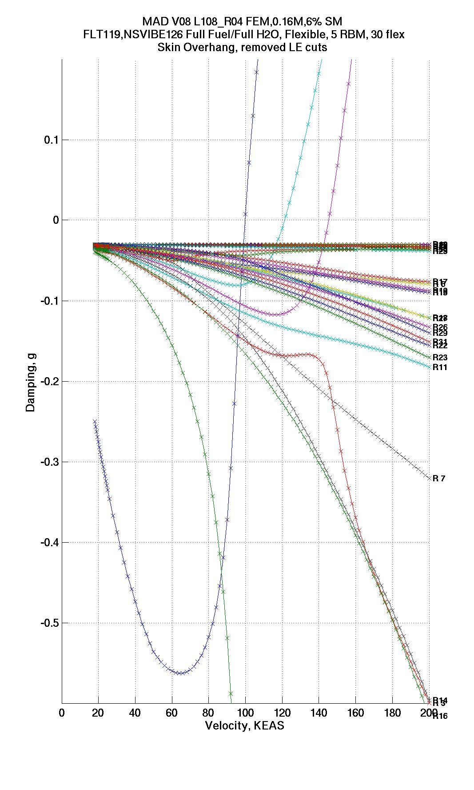
X-56A Flex - Full
Flex wing full fuel flutter emulates full size vehicle behavior
Body freedom flutter ~100 KEAS
Symmetric wing bending/torsion ~121 KEAS
Anti-symmetric wing bending/torsion ~145 KEAS
SWBT
UNSTABLE
BFF
AWBT
STABLE
AW1T
SW1T
AW1B
SW1B
Desired Flutter Band
Short Period
V_{L}
Demonstrator Achieves Desired Flutter Behavior

Slide 13
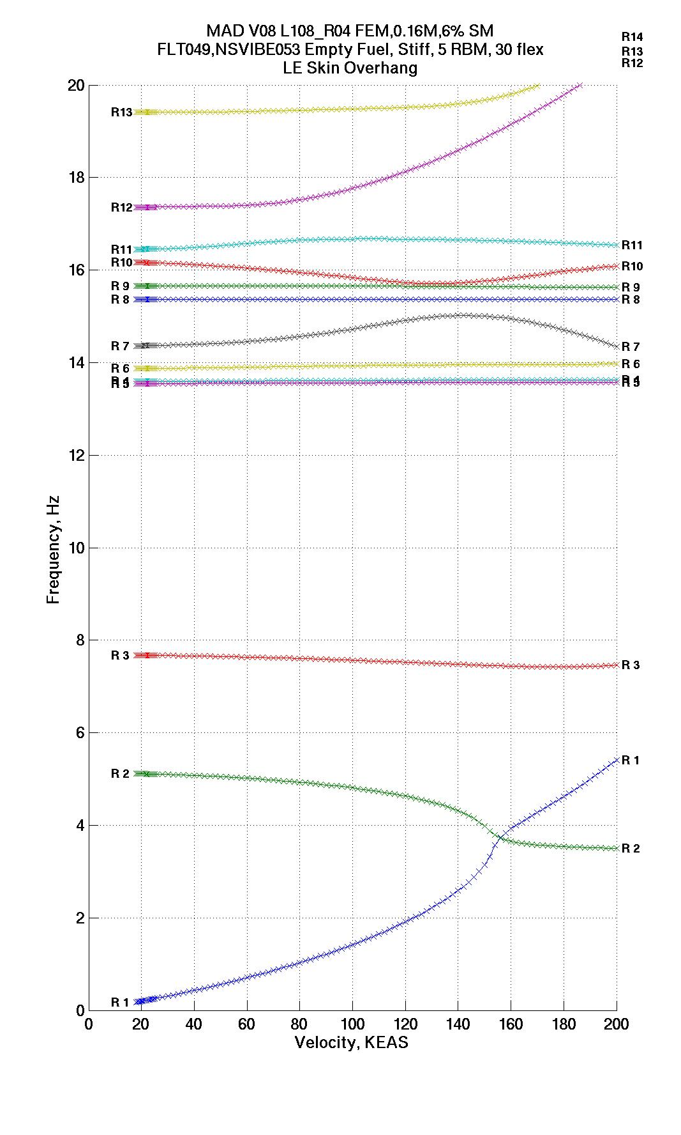
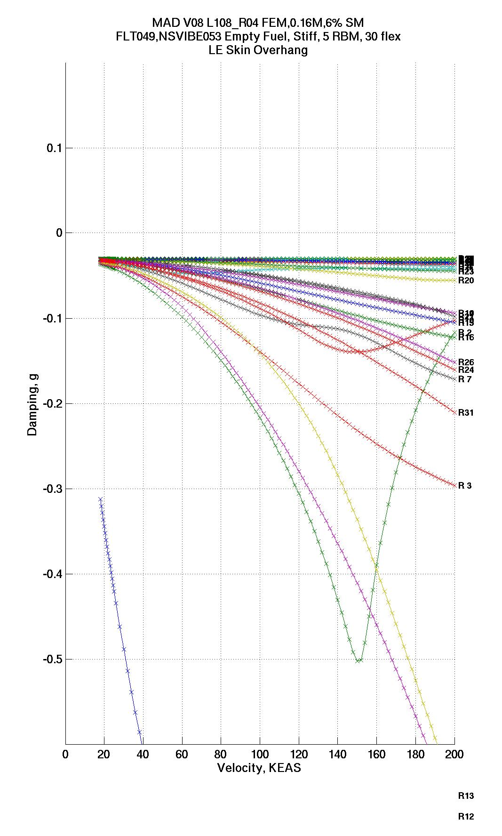
X-56A Stiff - Full
Stiff wing full fuel flutter achieves > 50% flutter margin
SW1T
UNSTABLE
STABLE
BFF
AW1B
SW1B
Desired Flutter Band
Short Period
V_{L}
Demonstrator Achieves Desired Flutter Behavior

Slide 14
Flight Control Considerations
MUTT integrated rigid/flexible vehicle control laws will simultaneously:
Produce desired rigid body flying qualities
Suppress BFF and symmetric and anti-symmetric wing bending/torsion
Reduce vehicle response due to gust to minimize loads
Integrated Rigid/Flexible Vehicle Control Essential to MAD/MUTT

Slide 15
Stabilization Over the Entire Flight Envelope → Regulator point designs every 20 KEAS → Closed-loop poles plotted every 10 KEAS
Structural Stabilization for SM = -3, 0, 3, 6%
3 Flutter Modes Stabilized Over the Flight Envelope

Slide 16
Zona Dynamic Flight Simulation
Zona DFS
Combines non-linear 6-DOF rigid body flight dynamic model with aeroelastic model
Simulates aeroelastic coupling between rigid body and flexible dynamics
Implementing on MAD in real time sim
Non-Linear
6DOF Sim Model
Delta Forces
Delta Moments
Sensor Deltas
Goal to Achieve Real Time Simulation of Rigid/Flex Coupling

Slide 17
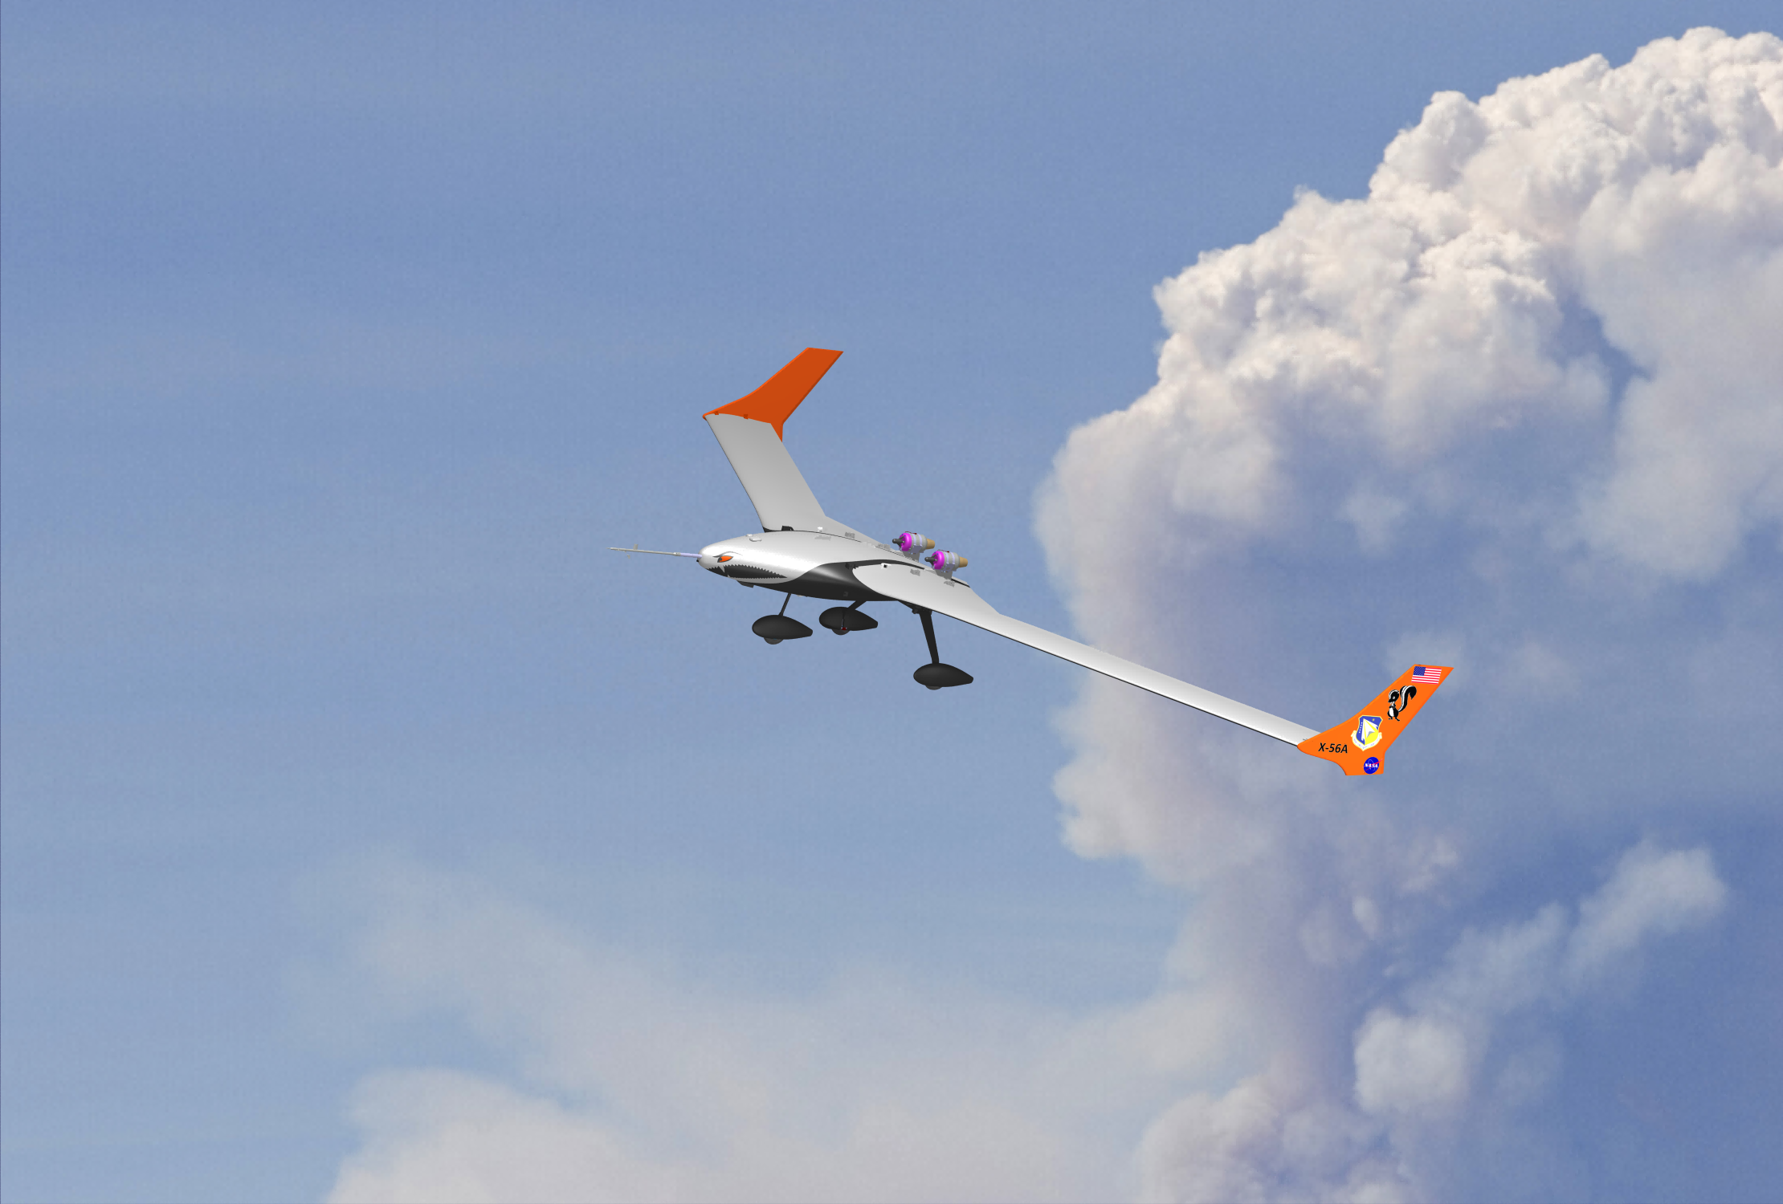
X-56A

Slide 18
Summary
BFF IRAD & CRAD
Successful integration of flight controls and flutter disciplines
Successful modeling of rigid/flex coupling:
On set speed
Mode frequencies
Demonstrated multi-flutter mode control via multiple methods
X-56A
Demonstrate integrated rigid body and flexible vehicle control for larger scale vehicle
Reconfigurable for further technology demonstrations of other vehicles

